Slide 1
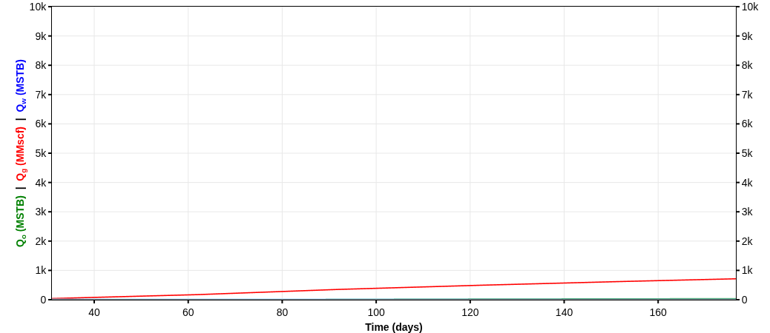
HALEY 9-13-9 1H
35017244250000
Technical Volumes at 9 July 2026
Summary
Country: UNITED STATES
County: CANADIAN
Sub-field: ANADARKO INTERMEDIATE SUB-BASIN (ANADARKO BASIN)
Reservoir: WTNG-CHCSH TREND
Operator: DEVON ENERGY PRODUCTION CO LP
Pad Name:
Reserves Classification:
Vintage:
Well Trajectory: horizontal
Fluid Pumped: 233392 STB
Proppant Pumped: 11876000 lbs
Stages: 0
Technical Volumes at 9 July 2026
Last Segment
Stream | Ultimate Volumes | Cumulative Production | Remaining Volumes | Total Production Time | D_{lim}(tan. eff) | Cutoff Rate
Segment | Start Date | q_{i} | D_{i}(sec. eff) | b
Oil | 147.12 | 56.05 | 91.07 | 50 yrs | 6.18 %/yr | 0
Gas | 7220 | 3951.52 | 3268.48 | 50 yrs | 6.26 %/yr | 0
Water | 0 | 0 | 0 | 50 yrs | - | 0
Oil | 2015-04-01 | 196.3 | 71.19 %/yr | 1
Gas | 2015-05-01 | 5454.95 | 59.72 %/yr | 1.4
Water | 2015-01-30 | 0 | - | -

Slide 2
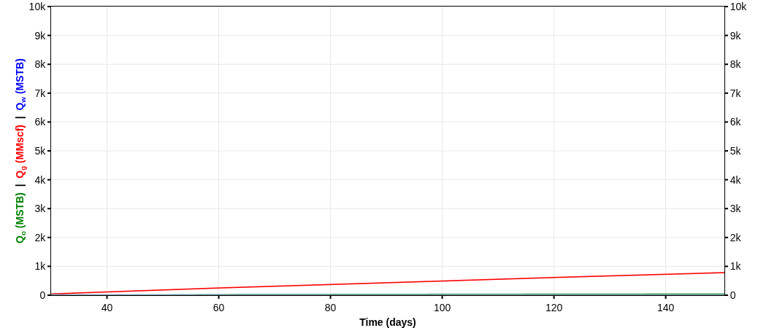
HALEY 9-13-9 4H
35017246700000
Technical Volumes at 9 July 2026
Summary
Country: UNITED STATES
County: CANADIAN
Sub-field: ANADARKO INTERMEDIATE SUB-BASIN (ANADARKO BASIN)
Reservoir: WTNG-CHCSH TREND
Operator: DEVON ENERGY PRODUCTION CO LP
Pad Name:
Reserves Classification:
Vintage:
Well Trajectory: horizontal
Fluid Pumped: 230904 STB
Proppant Pumped: 11806000 lbs
Stages: 0
Technical Volumes at 9 July 2026
Last Segment
Stream | Ultimate Volumes | Cumulative Production | Remaining Volumes | Total Production Time | D_{lim}(tan. eff) | Cutoff Rate
Segment | Start Date | q_{i} | D_{i}(sec. eff) | b
Oil | 125.42 | 79.98 | 45.44 | 50 yrs | 6.18 %/yr | 0
Gas | 7948.53 | 4623.08 | 3325.45 | 50 yrs | 6.22 %/yr | 0
Water | 0 | 0 | 0 | 50 yrs | - | 0
Oil | 2015-05-01 | 446.16 | 90.18 %/yr | 1
Gas | 2015-05-01 | 6897.84 | 60.86 %/yr | 1.22
Water | 2015-03-03 | 0 | - | -

Slide 3

HALEY 9-13-9 5H
35017246720000
Technical Volumes at 9 July 2026
Summary
Country: UNITED STATES
County: CANADIAN
Sub-field: ANADARKO INTERMEDIATE SUB-BASIN (ANADARKO BASIN)
Reservoir: WTNG-CHCSH TREND
Operator: DEVON ENERGY PRODUCTION CO LP
Pad Name:
Reserves Classification:
Vintage:
Well Trajectory: horizontal
Fluid Pumped: 234869 STB
Proppant Pumped: 12008000 lbs
Stages: 0
Technical Volumes at 9 July 2026
Last Segment
Stream | Ultimate Volumes | Cumulative Production | Remaining Volumes | Total Production Time | D_{lim}(tan. eff) | Cutoff Rate
Segment | Start Date | q_{i} | D_{i}(sec. eff) | b
Oil | 92.68 | 46.18 | 46.5 | 50 yrs | 6.18 %/yr | 0
Gas | 7110.59 | 4130.83 | 2979.76 | 50 yrs | 6.22 %/yr | 0
Water | 0 | 0 | 0 | 50 yrs | - | 0
Oil | 2015-06-01 | 334.87 | 90.91 %/yr | 1
Gas | 2015-05-01 | 7107.16 | 64.27 %/yr | 1.21
Water | 2015-03-03 | 0 | - | -

Slide 4
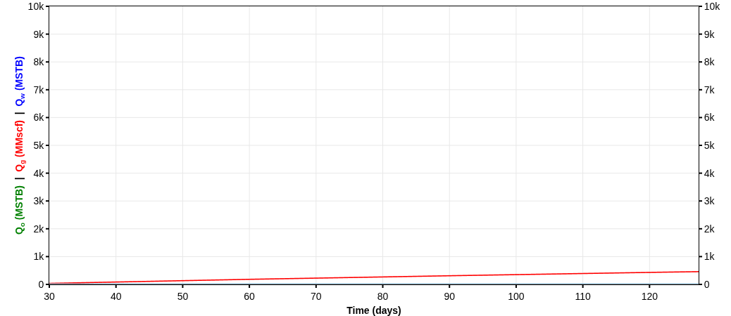
HALEY 9-13-9 6H
35017246790000
Technical Volumes at 9 July 2026
Summary
Country: UNITED STATES
County: CANADIAN
Sub-field: ANADARKO INTERMEDIATE SUB-BASIN (ANADARKO BASIN)
Reservoir: WTNG-CHCSH TREND
Operator: DEVON ENERGY PRODUCTION CO LP
Pad Name:
Reserves Classification:
Vintage:
Well Trajectory: horizontal
Fluid Pumped: 231539 STB
Proppant Pumped: 10846000 lbs
Stages: 0
Technical Volumes at 9 July 2026
Last Segment
Stream | Ultimate Volumes | Cumulative Production | Remaining Volumes | Total Production Time | D_{lim}(tan. eff) | Cutoff Rate
Segment | Start Date | q_{i} | D_{i}(sec. eff) | b
Oil | 106.13 | 24.43 | 81.7 | 50 yrs | 6.18 %/yr | 0
Gas | 5120.04 | 3005.14 | 2114.9 | 50 yrs | 6.22 %/yr | 0
Water | 0 | 0 | 0 | 50 yrs | - | 0
Oil | 2015-05-01 | 136.55 | 69.3 %/yr | 1
Gas | 2015-05-01 | 4944.03 | 62.88 %/yr | 1.18
Water | 2015-03-03 | 0 | - | -

Slide 5

HALEY 9-13-9 7H
35017247130000
Technical Volumes at 9 July 2026
Summary
Country: UNITED STATES
County: CANADIAN
Sub-field: ANADARKO INTERMEDIATE SUB-BASIN (ANADARKO BASIN)
Reservoir: WTNG-CHCSH TREND
Operator: DEVON ENERGY PRODUCTION CO LP
Pad Name:
Reserves Classification:
Vintage:
Well Trajectory: horizontal
Fluid Pumped: 179925 STB
Proppant Pumped: 9206000 lbs
Stages: 0
Technical Volumes at 9 July 2026
Last Segment
Stream | Ultimate Volumes | Cumulative Production | Remaining Volumes | Total Production Time | D_{lim}(tan. eff) | Cutoff Rate
Segment | Start Date | q_{i} | D_{i}(sec. eff) | b
Oil | 160.08 | 66.46 | 93.62 | 50 yrs | 6.18 %/yr | 0
Gas | 7276.67 | 4073.79 | 3202.88 | 50 yrs | 6.25 %/yr | 0
Water | 0 | 0 | 0 | 50 yrs | - | 0
Oil | 2015-05-01 | 242.12 | 74.69 %/yr | 1
Gas | 2015-05-01 | 6835.54 | 65.7 %/yr | 1.36
Water | 2015-01-30 | 0 | - | -

Slide 6
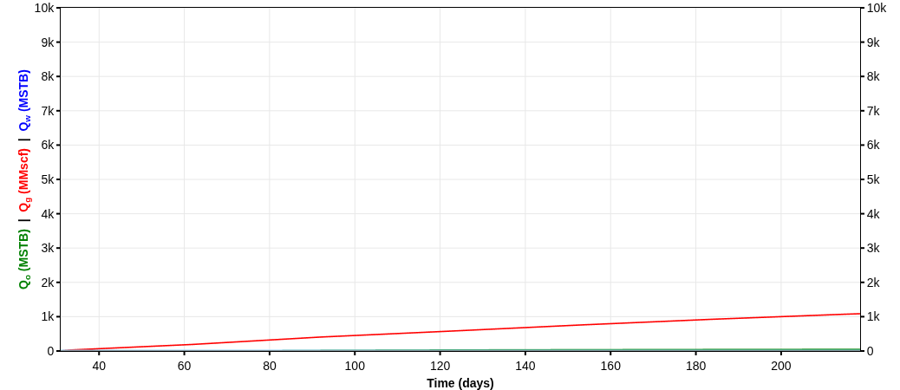
HALEY 9-13-9 2H
35017247180000
Technical Volumes at 9 July 2026
Summary
Country: UNITED STATES
County: CANADIAN
Sub-field: ANADARKO INTERMEDIATE SUB-BASIN (ANADARKO BASIN)
Reservoir: WTNG-CHCSH TREND
Operator: DEVON ENERGY PRODUCTION CO LP
Pad Name:
Reserves Classification:
Vintage:
Well Trajectory: horizontal
Fluid Pumped: 230948 STB
Proppant Pumped: 12032000 lbs
Stages: 0
Technical Volumes at 9 July 2026
Last Segment
Stream | Ultimate Volumes | Cumulative Production | Remaining Volumes | Total Production Time | D_{lim}(tan. eff) | Cutoff Rate
Segment | Start Date | q_{i} | D_{i}(sec. eff) | b
Oil | 182.11 | 69.2 | 112.9 | 50 yrs | 6.18 %/yr | 0
Gas | 8554.63 | 4782.52 | 3772.1 | 50 yrs | 6.25 %/yr | 0
Water | 0 | 0 | 0 | 50 yrs | - | 0
Oil | 2015-04-01 | 233.83 | 69.93 %/yr | 1
Gas | 2015-05-01 | 7163.68 | 62.38 %/yr | 1.36
Water | 2015-01-30 | 0 | - | -

Slide 7

HALEY 9-13-9 3H
35017247190000
Technical Volumes at 9 July 2026
Summary
Country: UNITED STATES
County: CANADIAN
Sub-field: ANADARKO INTERMEDIATE SUB-BASIN (ANADARKO BASIN)
Reservoir: WTNG-CHCSH TREND
Operator: DEVON ENERGY PRODUCTION CO LP
Pad Name:
Reserves Classification:
Vintage:
Well Trajectory: horizontal
Fluid Pumped: 229949 STB
Proppant Pumped: 12044000 lbs
Stages: 0
Technical Volumes at 9 July 2026
Last Segment
Stream | Ultimate Volumes | Cumulative Production | Remaining Volumes | Total Production Time | D_{lim}(tan. eff) | Cutoff Rate
Segment | Start Date | q_{i} | D_{i}(sec. eff) | b
Oil | 161.68 | 62.06 | 99.62 | 50 yrs | 6.18 %/yr | 0
Gas | 6897.24 | 4149.3 | 2747.94 | 50 yrs | 6.21 %/yr | 0
Water | 0 | 0 | 0 | 50 yrs | - | 0
Oil | 2015-05-01 | 231.26 | 73.14 %/yr | 1
Gas | 2015-05-01 | 6894.64 | 63.79 %/yr | 1.15
Water | 2015-01-30 | 0 | - | -

Slide 8

HALEY 9-13-9 8H
35017247210000
Technical Volumes at 9 July 2026
Summary
Country: UNITED STATES
County: CANADIAN
Sub-field: ANADARKO INTERMEDIATE SUB-BASIN (ANADARKO BASIN)
Reservoir: WTNG-CHCSH TREND
Operator: DEVON ENERGY OPERATING CO LP
Pad Name:
Reserves Classification:
Vintage:
Well Trajectory: horizontal
Fluid Pumped: 180508 STB
Proppant Pumped: 9184000 lbs
Stages: 0
Technical Volumes at 9 July 2026
Last Segment
Stream | Ultimate Volumes | Cumulative Production | Remaining Volumes | Total Production Time | D_{lim}(tan. eff) | Cutoff Rate
Segment | Start Date | q_{i} | D_{i}(sec. eff) | b
Oil | 161.71 | 56.65 | 105.06 | 50 yrs | 6.18 %/yr | 0
Gas | 6878.58 | 3986.05 | 2892.53 | 50 yrs | 6.23 %/yr | 0
Water | 0 | 0 | 0 | 50 yrs | - | 0
Oil | 2015-05-01 | 189.04 | 66.96 %/yr | 1
Gas | 2015-05-01 | 6566.04 | 63.49 %/yr | 1.22
Water | 2015-01-30 | 0 | - | -

Slide 9
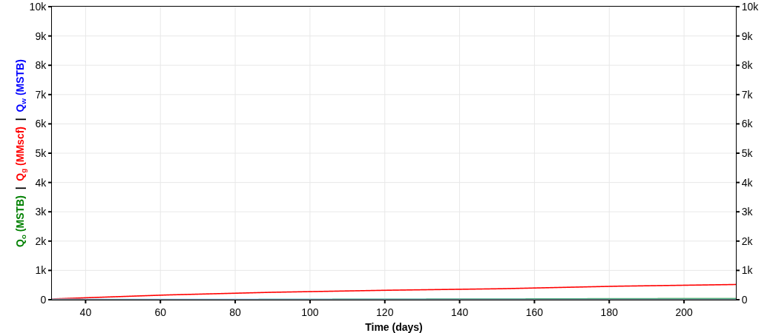
LEMKE 25-13N-9W 4H
35017247830000
Technical Volumes at 9 July 2026
Summary
Country: UNITED STATES
County: CANADIAN
Sub-field: ANADARKO INTERMEDIATE SUB-BASIN (ANADARKO BASIN)
Reservoir: CALUMET EAST
Operator: DEVON ENERGY PRODUCTION CO LP
Pad Name:
Reserves Classification:
Vintage:
Well Trajectory: horizontal
Fluid Pumped: 239811 STB
Proppant Pumped: 9032000 lbs
Stages: 0
Technical Volumes at 9 July 2026
Last Segment
Stream | Ultimate Volumes | Cumulative Production | Remaining Volumes | Total Production Time | D_{lim}(tan. eff) | Cutoff Rate
Segment | Start Date | q_{i} | D_{i}(sec. eff) | b
Oil | 178.22 | 69.46 | 108.76 | 50 yrs | 6.18 %/yr | 0
Gas | 4326.13 | 1990.92 | 2335.21 | 50 yrs | 6.29 %/yr | 0
Water | 0 | 0 | 0 | 50 yrs | - | 0
Oil | 2017-02-01 | 221.24 | 68.21 %/yr | 1
Gas | 2017-02-01 | 4409.47 | 70.24 %/yr | 1.56
Water | 2016-12-02 | 0 | - | -

Slide 10
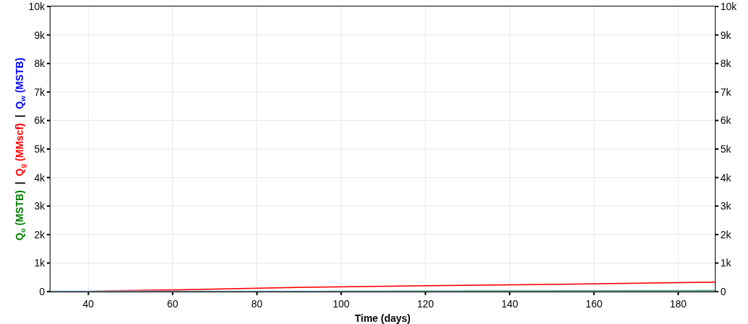
LEMKE 25-13N-9W 6H
35017247840000
Technical Volumes at 9 July 2026
Summary
Country: UNITED STATES
County: CANADIAN
Sub-field: ANADARKO INTERMEDIATE SUB-BASIN (ANADARKO BASIN)
Reservoir: WTNG-CHCSH TREND
Operator: DEVON ENERGY PRODUCTION CO LP
Pad Name:
Reserves Classification:
Vintage:
Well Trajectory: horizontal
Fluid Pumped: 315578 STB
Proppant Pumped: 11918000 lbs
Stages: 30
Technical Volumes at 9 July 2026
Last Segment
Stream | Ultimate Volumes | Cumulative Production | Remaining Volumes | Total Production Time | D_{lim}(tan. eff) | Cutoff Rate
Segment | Start Date | q_{i} | D_{i}(sec. eff) | b
Oil | 157.24 | 70.97 | 86.27 | 50 yrs | 6.18 %/yr | 0
Gas | 2766.87 | 1349.63 | 1417.24 | 50 yrs | 6.29 %/yr | 0
Water | 0 | 0 | 0 | 50 yrs | - | 0
Oil | 2017-03-01 | 216.88 | 72.31 %/yr | 1
Gas | 2017-03-01 | 2988.68 | 72.71 %/yr | 1.54
Water | 2016-12-02 | 0 | - | -

Slide 11

LEMKE 25-13N-9W 3H
35017247850000
Technical Volumes at 9 July 2026
Summary
Country: UNITED STATES
County: CANADIAN
Sub-field: ANADARKO INTERMEDIATE SUB-BASIN (ANADARKO BASIN)
Reservoir: WTNG-CHCSH TREND
Operator: DEVON ENERGY PRODUCTION CO LP
Pad Name:
Reserves Classification:
Vintage:
Well Trajectory: horizontal
Fluid Pumped: 260655.86 STB
Proppant Pumped: 9784000 lbs
Stages: 0
Technical Volumes at 9 July 2026
Last Segment
Stream | Ultimate Volumes | Cumulative Production | Remaining Volumes | Total Production Time | D_{lim}(tan. eff) | Cutoff Rate
Segment | Start Date | q_{i} | D_{i}(sec. eff) | b
Oil | 154.89 | 68 | 86.89 | 50 yrs | 6.18 %/yr | 0
Gas | 5023.74 | 2247.21 | 2776.53 | 50 yrs | 6.33 %/yr | 0
Water | 0 | 0 | 0 | 50 yrs | - | 0
Oil | 2017-02-01 | 221.86 | 72.39 %/yr | 1
Gas | 2017-02-01 | 4365.75 | 69.09 %/yr | 1.8
Water | 2016-12-02 | 0 | - | -

Slide 12
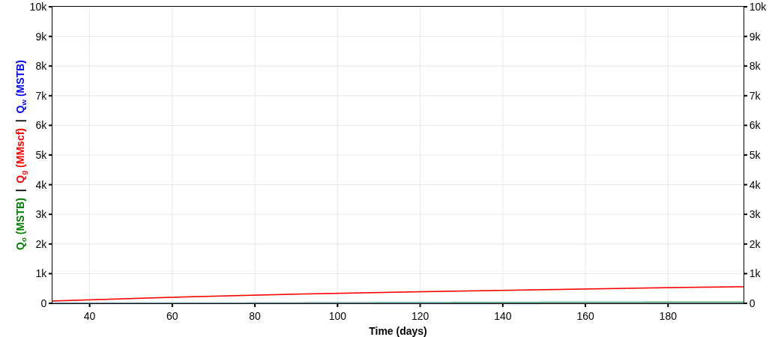
LEMKE 25-13N-9W 2H
35017247860000
Technical Volumes at 9 July 2026
Summary
Country: UNITED STATES
County: CANADIAN
Sub-field: ANADARKO INTERMEDIATE SUB-BASIN (ANADARKO BASIN)
Reservoir: WTNG-CHCSH TREND
Operator: DEVON ENERGY PRODUCTION CO LP
Pad Name:
Reserves Classification:
Vintage:
Well Trajectory: horizontal
Fluid Pumped: 262103.86 STB
Proppant Pumped: 9452000 lbs
Stages: 0
Technical Volumes at 9 July 2026
Last Segment
Stream | Ultimate Volumes | Cumulative Production | Remaining Volumes | Total Production Time | D_{lim}(tan. eff) | Cutoff Rate
Segment | Start Date | q_{i} | D_{i}(sec. eff) | b
Oil | 165.23 | 71.74 | 93.49 | 50 yrs | 6.18 %/yr | 0
Gas | 4626.42 | 2088.2 | 2538.22 | 50 yrs | 6.34 %/yr | 0
Water | 0 | 0 | 0 | 50 yrs | - | 0
Oil | 2017-02-01 | 223.96 | 71.01 %/yr | 1
Gas | 2017-02-01 | 4288.25 | 71.07 %/yr | 1.8
Water | 2016-12-02 | 0 | - | -

Slide 13
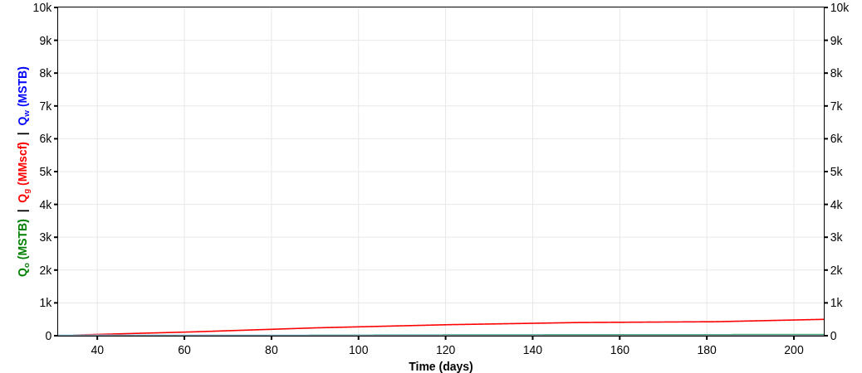
LEMKE 25-13N-9W 5H
35017247870000
Technical Volumes at 9 July 2026
Summary
Country: UNITED STATES
County: CANADIAN
Sub-field: ANADARKO INTERMEDIATE SUB-BASIN (ANADARKO BASIN)
Reservoir: WTNG-CHCSH TREND
Operator: DEVON ENERGY PRODUCTION CO LP
Pad Name:
Reserves Classification:
Vintage:
Well Trajectory: horizontal
Fluid Pumped: 325769 STB
Proppant Pumped: 11870000 lbs
Stages: 30
Technical Volumes at 9 July 2026
Last Segment
Stream | Ultimate Volumes | Cumulative Production | Remaining Volumes | Total Production Time | D_{lim}(tan. eff) | Cutoff Rate
Segment | Start Date | q_{i} | D_{i}(sec. eff) | b
Oil | 172.39 | 72.72 | 99.67 | 50 yrs | 6.18 %/yr | 0
Gas | 5015.3 | 2358.93 | 2656.37 | 50 yrs | 6.25 %/yr | 0
Water | 0 | 0 | 0 | 50 yrs | - | 0
Oil | 2017-03-01 | 223.74 | 69.83 %/yr | 1
Gas | 2017-03-01 | 3549.97 | 55.42 %/yr | 1.34
Water | 2016-12-02 | 0 | - | -

Slide 14

HOBSON 26-13N-9W 2H
35017247960000
Technical Volumes at 9 July 2026
Summary
Country: UNITED STATES
County: CANADIAN
Sub-field: ANADARKO INTERMEDIATE SUB-BASIN (ANADARKO BASIN)
Reservoir: WTNG-CHCSH TREND
Operator: DEVON ENERGY PRODUCTION CO LP
Pad Name:
Reserves Classification:
Vintage:
Well Trajectory: horizontal
Fluid Pumped: 258515.19 STB
Proppant Pumped: 8300000 lbs
Stages: 0
Technical Volumes at 9 July 2026
Last Segment
Stream | Ultimate Volumes | Cumulative Production | Remaining Volumes | Total Production Time | D_{lim}(tan. eff) | Cutoff Rate
Segment | Start Date | q_{i} | D_{i}(sec. eff) | b
Oil | 192.47 | 43.72 | 148.76 | 50 yrs | 6.18 %/yr | 0
Gas | 3217.26 | 1774.93 | 1442.33 | 50 yrs | 6.2 %/yr | 0
Water | 0 | 0 | 0 | 50 yrs | - | 0
Oil | 2017-01-01 | 101.24 | 37.3 %/yr | 1
Gas | 2016-12-01 | 3289.45 | 62.61 %/yr | 1.08
Water | 2016-10-03 | 0 | - | -

Slide 15
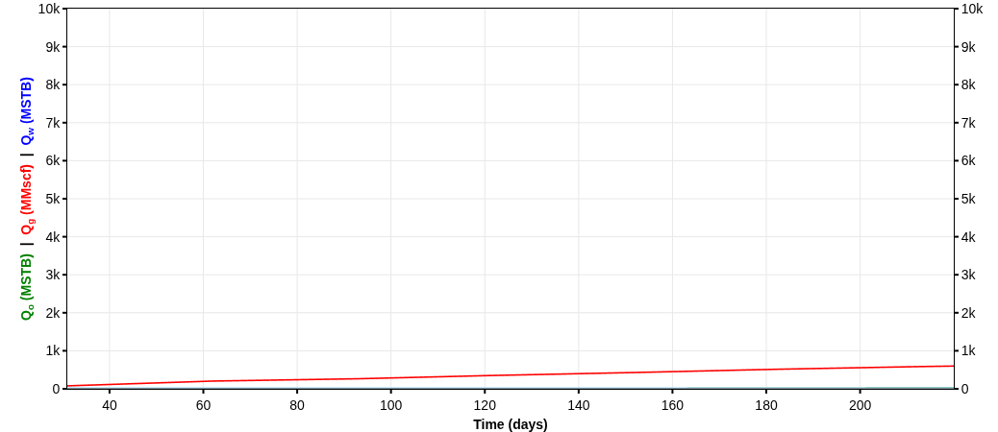
HOBSON 26-13N-9W 3H
35017247970000
Technical Volumes at 9 July 2026
Summary
Country: UNITED STATES
County: CANADIAN
Sub-field: ANADARKO INTERMEDIATE SUB-BASIN (ANADARKO BASIN)
Reservoir: WTNG-CHCSH TREND
Operator: DEVON ENERGY PRODUCTION CO LP
Pad Name:
Reserves Classification:
Vintage:
Well Trajectory: horizontal
Fluid Pumped: 335250 STB
Proppant Pumped: 9006000 lbs
Stages: 30
Technical Volumes at 9 July 2026
Last Segment
Stream | Ultimate Volumes | Cumulative Production | Remaining Volumes | Total Production Time | D_{lim}(tan. eff) | Cutoff Rate
Segment | Start Date | q_{i} | D_{i}(sec. eff) | b
Oil | 183.3 | 50.61 | 132.69 | 50 yrs | 6.18 %/yr | 0
Gas | 5869.55 | 2800.05 | 3069.49 | 50 yrs | 6.19 %/yr | 0
Water | 0 | 0 | 0 | 50 yrs | - | 0
Oil | 2017-01-01 | 118.62 | 45.95 %/yr | 1
Gas | 2017-01-01 | 2978.12 | 37.99 %/yr | 1.05
Water | 2016-11-01 | 0 | - | -

Slide 16

HOBSON 26-13N-9W 4H
35017247980000
Technical Volumes at 9 July 2026
Summary
Country: UNITED STATES
County: CANADIAN
Sub-field: ANADARKO INTERMEDIATE SUB-BASIN (ANADARKO BASIN)
Reservoir: WTNG-CHCSH TREND
Operator: DEVON ENERGY PRODUCTION CO LP
Pad Name:
Reserves Classification:
Vintage:
Well Trajectory: horizontal
Fluid Pumped: 346386 STB
Proppant Pumped: 10920000 lbs
Stages: 30
Technical Volumes at 9 July 2026
Last Segment
Stream | Ultimate Volumes | Cumulative Production | Remaining Volumes | Total Production Time | D_{lim}(tan. eff) | Cutoff Rate
Segment | Start Date | q_{i} | D_{i}(sec. eff) | b
Oil | 168.8 | 58.81 | 109.99 | 50 yrs | 6.18 %/yr | 0
Gas | 7736.37 | 3786.07 | 3950.3 | 50 yrs | 6.2 %/yr | 0
Water | 0 | 0 | 0 | 50 yrs | - | 0
Oil | 2017-03-01 | 125.04 | 52.22 %/yr | 1
Gas | 2017-01-01 | 4805.54 | 46.22 %/yr | 1.11
Water | 2016-11-01 | 0 | - | -

Slide 17

HOBSON 26-13N-9W 5H
35017247990000
Technical Volumes at 9 July 2026
Summary
Country: UNITED STATES
County: CANADIAN
Sub-field: ANADARKO INTERMEDIATE SUB-BASIN (ANADARKO BASIN)
Reservoir: WTNG-CHCSH TREND
Operator: DEVON ENERGY PRODUCTION CO LP
Pad Name:
Reserves Classification:
Vintage:
Well Trajectory: horizontal
Fluid Pumped: 316805 STB
Proppant Pumped: 10562000 lbs
Stages: 0
Technical Volumes at 9 July 2026
Last Segment
Stream | Ultimate Volumes | Cumulative Production | Remaining Volumes | Total Production Time | D_{lim}(tan. eff) | Cutoff Rate
Segment | Start Date | q_{i} | D_{i}(sec. eff) | b
Oil | 196.32 | 54.88 | 141.44 | 50 yrs | 6.18 %/yr | 0
Gas | 6826.87 | 3007.66 | 3819.21 | 50 yrs | 6.31 %/yr | 0
Water | 0 | 0 | 0 | 50 yrs | - | 0
Oil | 2017-03-01 | 116.51 | 45.24 %/yr | 1
Gas | 2017-03-01 | 3857.43 | 52.86 %/yr | 1.65
Water | 2016-11-01 | 0 | - | -

Slide 18
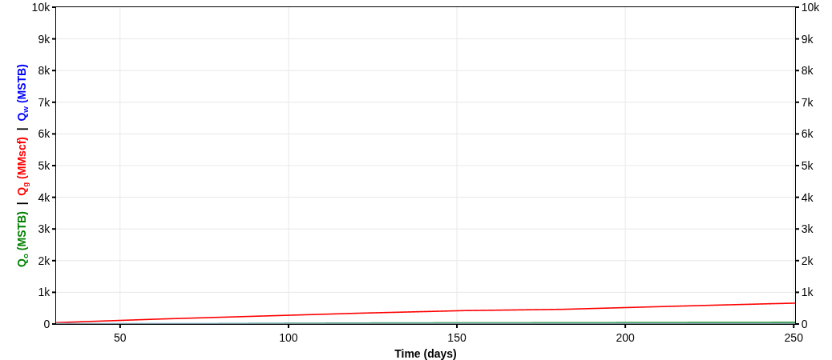
HOBSON 26-13N-9W 6H
35017248000000
Technical Volumes at 9 July 2026
Summary
Country: UNITED STATES
County: CANADIAN
Sub-field: ANADARKO INTERMEDIATE SUB-BASIN (ANADARKO BASIN)
Reservoir: WTNG-CHCSH TREND
Operator: DEVON ENERGY PRODUCTION CO LP
Pad Name:
Reserves Classification:
Vintage:
Well Trajectory: horizontal
Fluid Pumped: 328824 STB
Proppant Pumped: 10340000 lbs
Stages: 0
Technical Volumes at 9 July 2026
Last Segment
Stream | Ultimate Volumes | Cumulative Production | Remaining Volumes | Total Production Time | D_{lim}(tan. eff) | Cutoff Rate
Segment | Start Date | q_{i} | D_{i}(sec. eff) | b
Oil | 208.68 | 90.19 | 118.49 | 50 yrs | 6.18 %/yr | 0
Gas | 5838.25 | 2690.44 | 3147.81 | 50 yrs | 6.25 %/yr | 0
Water | 0 | 0 | 0 | 50 yrs | - | 0
Oil | 2017-01-01 | 240.3 | 66.35 %/yr | 1
Gas | 2017-01-01 | 3668.4 | 50.7 %/yr | 1.33
Water | 2016-11-01 | 0 | - | -

Slide 19
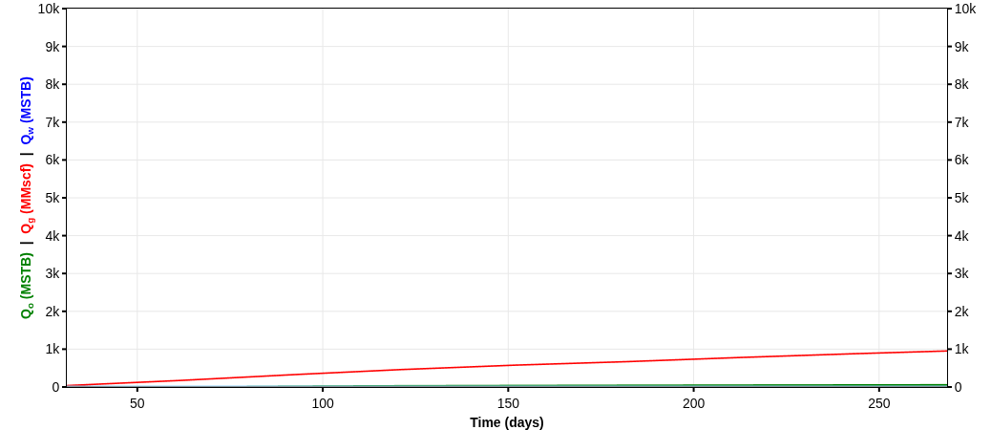
HOBSON 26-13N-9W 7H
35017248010000
Technical Volumes at 9 July 2026
Summary
Country: UNITED STATES
County: CANADIAN
Sub-field: ANADARKO INTERMEDIATE SUB-BASIN (ANADARKO BASIN)
Reservoir: WTNG-CHCSH TREND
Operator: DEVON ENERGY PRODUCTION CO LP
Pad Name:
Reserves Classification:
Vintage:
Well Trajectory: horizontal
Fluid Pumped: 324888 STB
Proppant Pumped: 11146000 lbs
Stages: 30
Technical Volumes at 9 July 2026
Last Segment
Stream | Ultimate Volumes | Cumulative Production | Remaining Volumes | Total Production Time | D_{lim}(tan. eff) | Cutoff Rate
Segment | Start Date | q_{i} | D_{i}(sec. eff) | b
Oil | 223.6 | 104.75 | 118.85 | 50 yrs | 6.18 %/yr | 0
Gas | 7832.19 | 3528.7 | 4303.49 | 50 yrs | 6.29 %/yr | 0
Water | 0 | 0 | 0 | 50 yrs | - | 0
Oil | 2017-02-01 | 244 | 65.82 %/yr | 1
Gas | 2017-02-01 | 5028.49 | 55.52 %/yr | 1.54
Water | 2016-11-01 | 0 | - | -

Slide 20
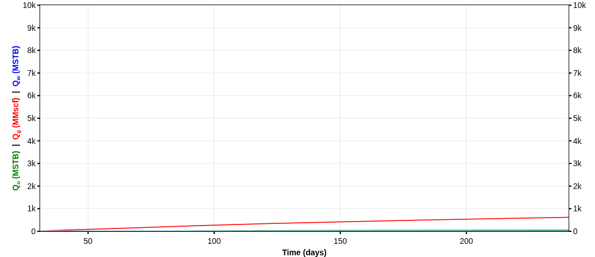
HOBSON 26-13N-9W 8H
35017248020000
Technical Volumes at 9 July 2026
Summary
Country: UNITED STATES
County: CANADIAN
Sub-field: ANADARKO INTERMEDIATE SUB-BASIN (ANADARKO BASIN)
Reservoir: WTNG-CHCSH TREND
Operator: DEVON ENERGY PRODUCTION CO LP
Pad Name:
Reserves Classification:
Vintage:
Well Trajectory: horizontal
Fluid Pumped: 243112 STB
Proppant Pumped: 9344000 lbs
Stages: 30
Technical Volumes at 9 July 2026
Last Segment
Stream | Ultimate Volumes | Cumulative Production | Remaining Volumes | Total Production Time | D_{lim}(tan. eff) | Cutoff Rate
Segment | Start Date | q_{i} | D_{i}(sec. eff) | b
Oil | 200.43 | 87.03 | 113.4 | 50 yrs | 6.18 %/yr | 0
Gas | 4712.63 | 2260.22 | 2452.41 | 50 yrs | 6.27 %/yr | 0
Water | 0 | 0 | 0 | 50 yrs | - | 0
Oil | 2017-02-01 | 235.58 | 67.77 %/yr | 1
Gas | 2017-02-01 | 3843.96 | 63 %/yr | 1.44
Water | 2016-11-01 | 0 | - | -

