Slide 1
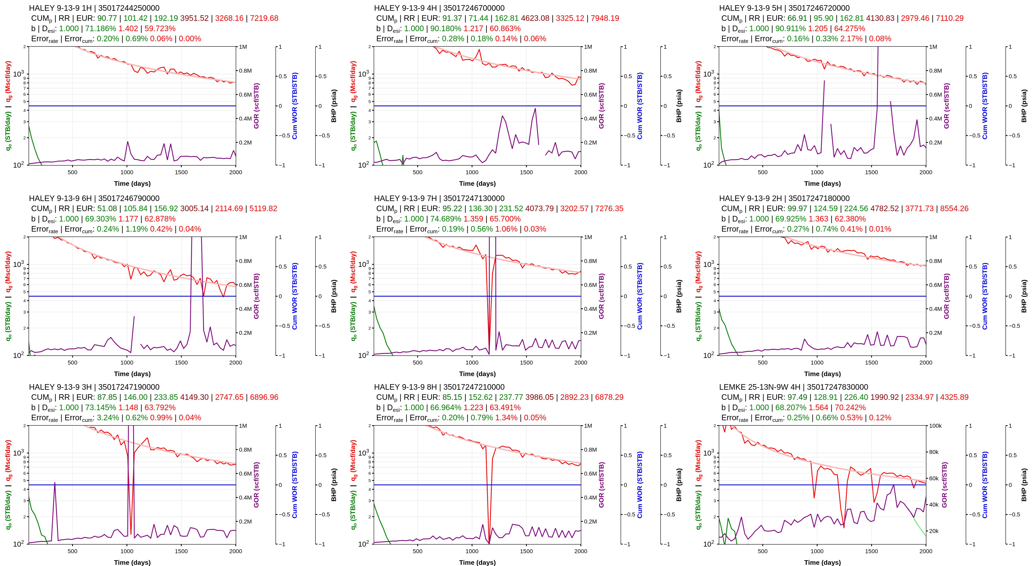
Bulk View (1/3)
9 July 2026

Slide 2
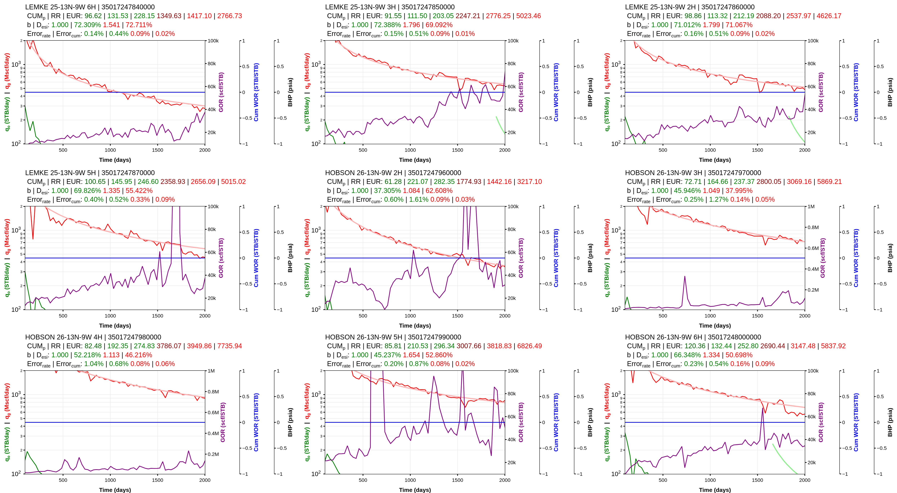
Bulk View (2/3)
9 July 2026

Slide 3
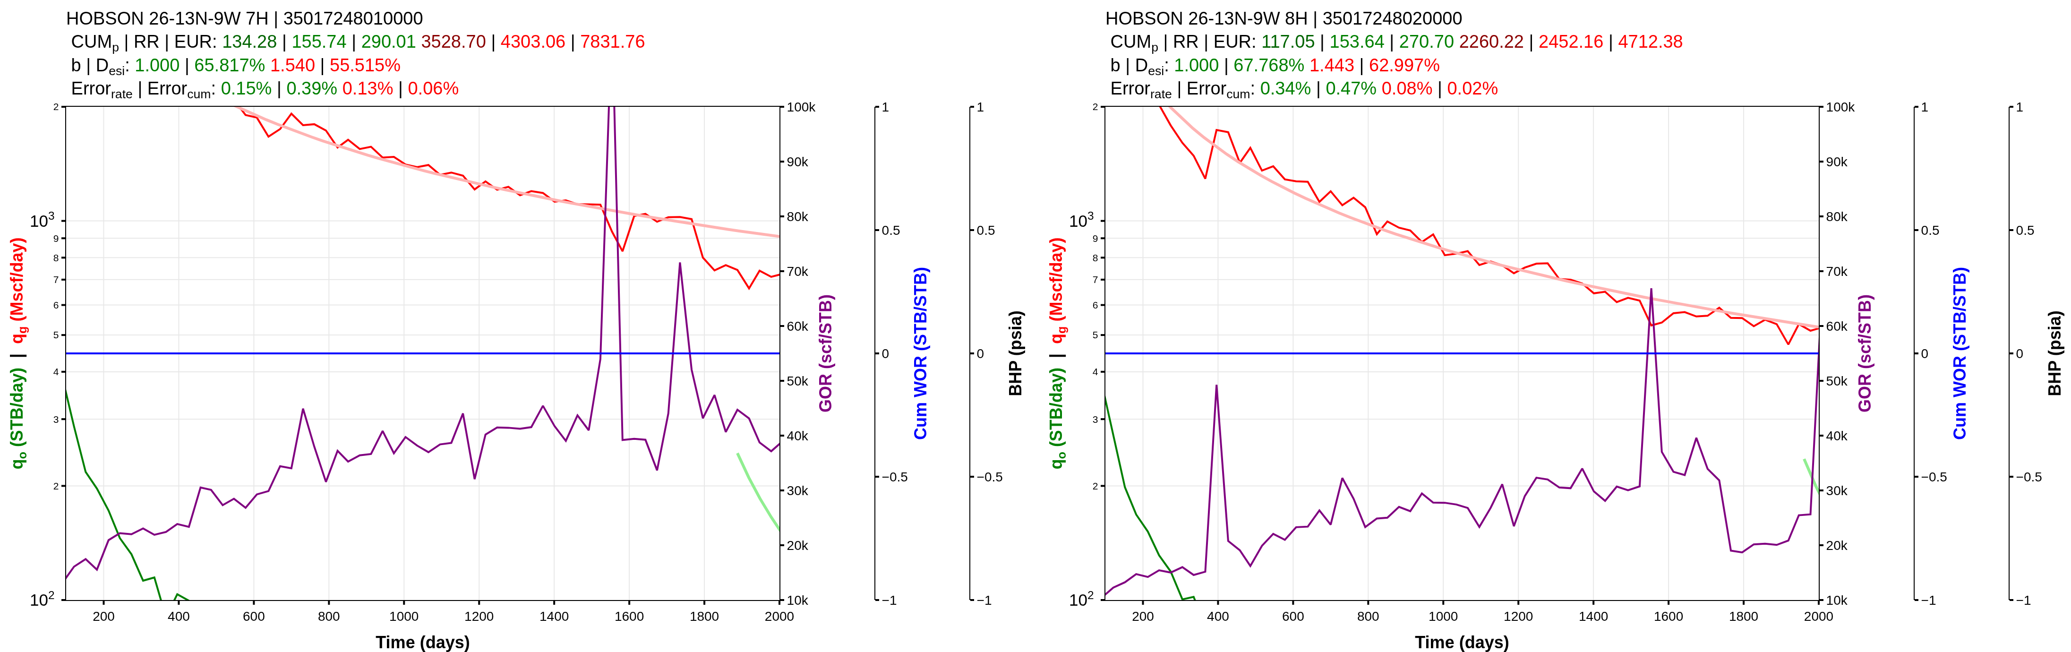
Bulk View (3/3)
9 July 2026

