Slide 1
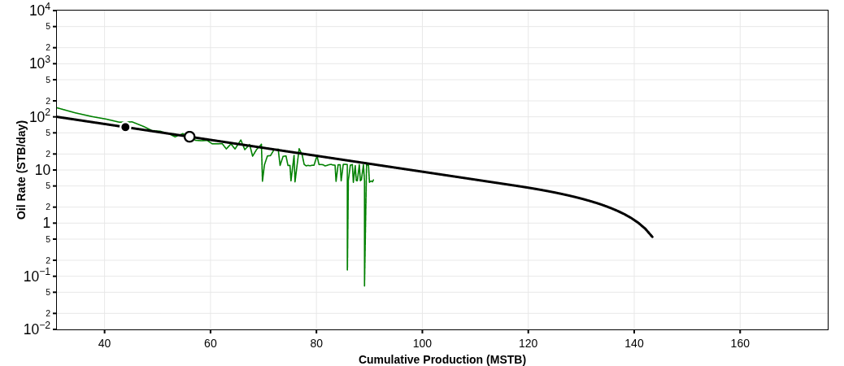
HALEY 9-13-9 1H
35017244250000
Technical Volumes at 9 July 2026
Summary
Country: UNITED STATES
County: CANADIAN
Reservoir: WTNG-CHCSH TREND
Operator: DEVON ENERGY PRODUCTION CO LP
Pad Name:
Reserves Classification:
Vintage:
Well Trajectory: horizontal
Lateral Length: 4700 ft
Fluid Pumped: 233392 STB
Proppant Pumped: 11876000 lbs
Stages: 0
Clusters:
Well Spacing:
Technical Volumes at 9 July 2026
Last Segment
Stream | Ultimate Volumes | Cumulative Production | Remaining Volumes | Total Production Time | D_{lim}(tan. eff) | Cutoff Rate
Segment | Start Date | q_{i} | D_{i}(sec. eff) | b
Oil | 147.12 | 56.05 | 91.07 | 50 yrs | 6.18 %/yr | 0
Oil | 2015-04-01 | 196.3 | 71.19 %/yr | 1

Slide 2
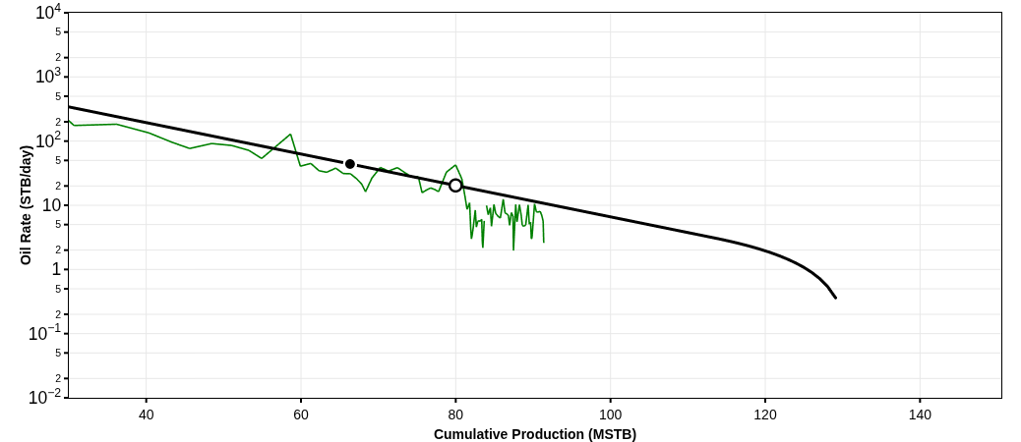
HALEY 9-13-9 4H
35017246700000
Technical Volumes at 9 July 2026
Summary
Country: UNITED STATES
County: CANADIAN
Reservoir: WTNG-CHCSH TREND
Operator: DEVON ENERGY PRODUCTION CO LP
Pad Name:
Reserves Classification:
Vintage:
Well Trajectory: horizontal
Lateral Length: 4672 ft
Fluid Pumped: 230904 STB
Proppant Pumped: 11806000 lbs
Stages: 0
Clusters:
Well Spacing:
Technical Volumes at 9 July 2026
Last Segment
Stream | Ultimate Volumes | Cumulative Production | Remaining Volumes | Total Production Time | D_{lim}(tan. eff) | Cutoff Rate
Segment | Start Date | q_{i} | D_{i}(sec. eff) | b
Oil | 125.42 | 79.98 | 45.44 | 50 yrs | 6.18 %/yr | 0
Oil | 2015-05-01 | 446.16 | 90.18 %/yr | 1

Slide 3
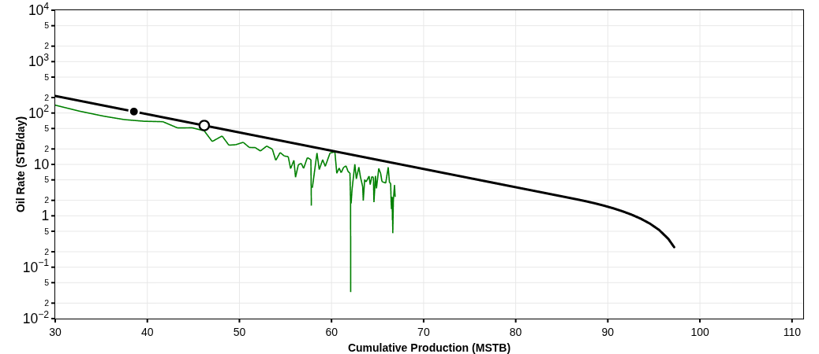
HALEY 9-13-9 5H
35017246720000
Technical Volumes at 9 July 2026
Summary
Country: UNITED STATES
County: CANADIAN
Reservoir: WTNG-CHCSH TREND
Operator: DEVON ENERGY PRODUCTION CO LP
Pad Name:
Reserves Classification:
Vintage:
Well Trajectory: horizontal
Lateral Length: 4752 ft
Fluid Pumped: 234869 STB
Proppant Pumped: 12008000 lbs
Stages: 0
Clusters:
Well Spacing:
Technical Volumes at 9 July 2026
Last Segment
Stream | Ultimate Volumes | Cumulative Production | Remaining Volumes | Total Production Time | D_{lim}(tan. eff) | Cutoff Rate
Segment | Start Date | q_{i} | D_{i}(sec. eff) | b
Oil | 92.68 | 46.18 | 46.5 | 50 yrs | 6.18 %/yr | 0
Oil | 2015-06-01 | 334.87 | 90.91 %/yr | 1

Slide 4
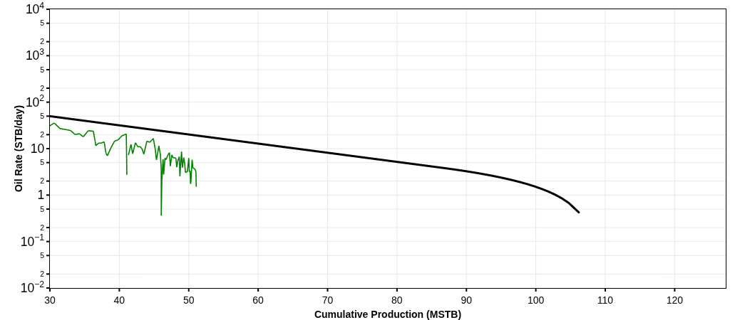
HALEY 9-13-9 6H
35017246790000
Technical Volumes at 9 July 2026
Summary
Country: UNITED STATES
County: CANADIAN
Reservoir: WTNG-CHCSH TREND
Operator: DEVON ENERGY PRODUCTION CO LP
Pad Name:
Reserves Classification:
Vintage:
Well Trajectory: horizontal
Lateral Length: 4657 ft
Fluid Pumped: 231539 STB
Proppant Pumped: 10846000 lbs
Stages: 0
Clusters:
Well Spacing:
Technical Volumes at 9 July 2026
Last Segment
Stream | Ultimate Volumes | Cumulative Production | Remaining Volumes | Total Production Time | D_{lim}(tan. eff) | Cutoff Rate
Segment | Start Date | q_{i} | D_{i}(sec. eff) | b
Oil | 106.13 | 24.43 | 81.7 | 50 yrs | 6.18 %/yr | 0
Oil | 2015-05-01 | 136.55 | 69.3 %/yr | 1

Slide 5
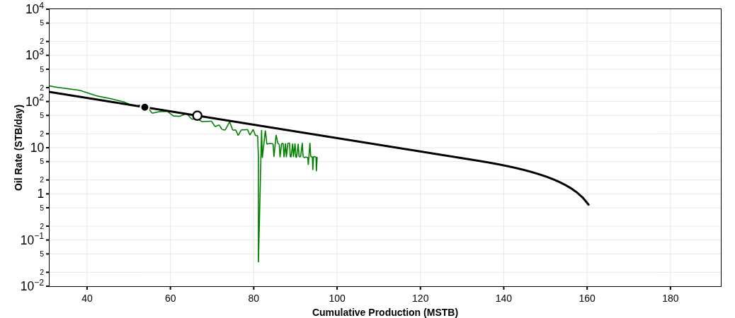
HALEY 9-13-9 7H
35017247130000
Technical Volumes at 9 July 2026
Summary
Country: UNITED STATES
County: CANADIAN
Reservoir: WTNG-CHCSH TREND
Operator: DEVON ENERGY PRODUCTION CO LP
Pad Name:
Reserves Classification:
Vintage:
Well Trajectory: horizontal
Lateral Length: 4524 ft
Fluid Pumped: 179925 STB
Proppant Pumped: 9206000 lbs
Stages: 0
Clusters:
Well Spacing:
Technical Volumes at 9 July 2026
Last Segment
Stream | Ultimate Volumes | Cumulative Production | Remaining Volumes | Total Production Time | D_{lim}(tan. eff) | Cutoff Rate
Segment | Start Date | q_{i} | D_{i}(sec. eff) | b
Oil | 160.08 | 66.46 | 93.62 | 50 yrs | 6.18 %/yr | 0
Oil | 2015-05-01 | 242.12 | 74.69 %/yr | 1

Slide 6
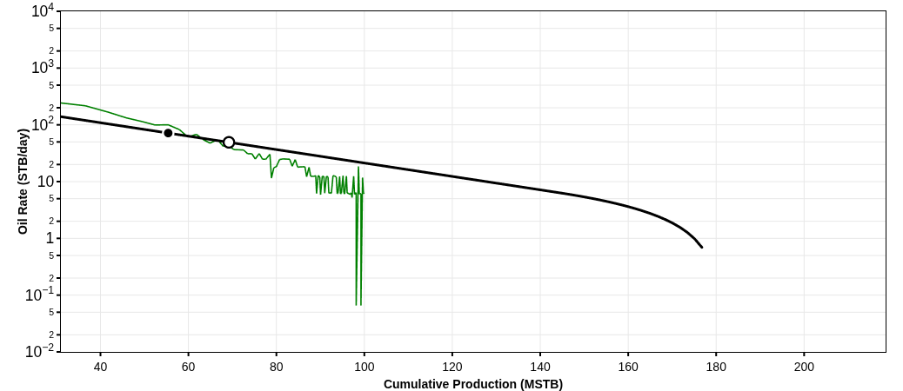
HALEY 9-13-9 2H
35017247180000
Technical Volumes at 9 July 2026
Summary
Country: UNITED STATES
County: CANADIAN
Reservoir: WTNG-CHCSH TREND
Operator: DEVON ENERGY PRODUCTION CO LP
Pad Name:
Reserves Classification:
Vintage:
Well Trajectory: horizontal
Lateral Length: 4619 ft
Fluid Pumped: 230948 STB
Proppant Pumped: 12032000 lbs
Stages: 0
Clusters:
Well Spacing:
Technical Volumes at 9 July 2026
Last Segment
Stream | Ultimate Volumes | Cumulative Production | Remaining Volumes | Total Production Time | D_{lim}(tan. eff) | Cutoff Rate
Segment | Start Date | q_{i} | D_{i}(sec. eff) | b
Oil | 182.11 | 69.2 | 112.9 | 50 yrs | 6.18 %/yr | 0
Oil | 2015-04-01 | 233.83 | 69.93 %/yr | 1

Slide 7
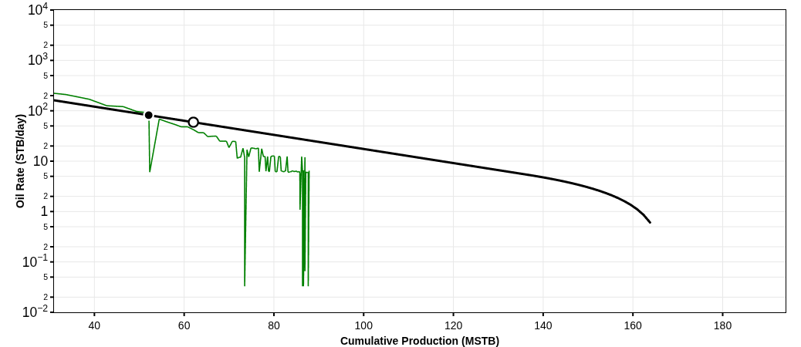
HALEY 9-13-9 3H
35017247190000
Technical Volumes at 9 July 2026
Summary
Country: UNITED STATES
County: CANADIAN
Reservoir: WTNG-CHCSH TREND
Operator: DEVON ENERGY PRODUCTION CO LP
Pad Name:
Reserves Classification:
Vintage:
Well Trajectory: horizontal
Lateral Length: 4440 ft
Fluid Pumped: 229949 STB
Proppant Pumped: 12044000 lbs
Stages: 0
Clusters:
Well Spacing:
Technical Volumes at 9 July 2026
Last Segment
Stream | Ultimate Volumes | Cumulative Production | Remaining Volumes | Total Production Time | D_{lim}(tan. eff) | Cutoff Rate
Segment | Start Date | q_{i} | D_{i}(sec. eff) | b
Oil | 161.68 | 62.06 | 99.62 | 50 yrs | 6.18 %/yr | 0
Oil | 2015-05-01 | 231.26 | 73.14 %/yr | 1

Slide 8
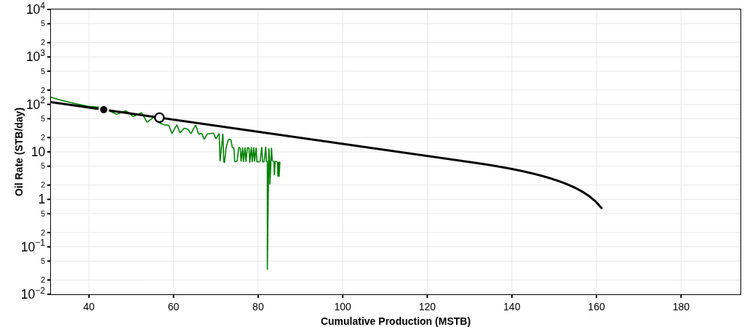
HALEY 9-13-9 8H
35017247210000
Technical Volumes at 9 July 2026
Summary
Country: UNITED STATES
County: CANADIAN
Reservoir: WTNG-CHCSH TREND
Operator: DEVON ENERGY OPERATING CO LP
Pad Name:
Reserves Classification:
Vintage:
Well Trajectory: horizontal
Lateral Length: 4663 ft
Fluid Pumped: 180508 STB
Proppant Pumped: 9184000 lbs
Stages: 0
Clusters:
Well Spacing:
Technical Volumes at 9 July 2026
Last Segment
Stream | Ultimate Volumes | Cumulative Production | Remaining Volumes | Total Production Time | D_{lim}(tan. eff) | Cutoff Rate
Segment | Start Date | q_{i} | D_{i}(sec. eff) | b
Oil | 161.71 | 56.65 | 105.06 | 50 yrs | 6.18 %/yr | 0
Oil | 2015-05-01 | 189.04 | 66.96 %/yr | 1

Slide 9
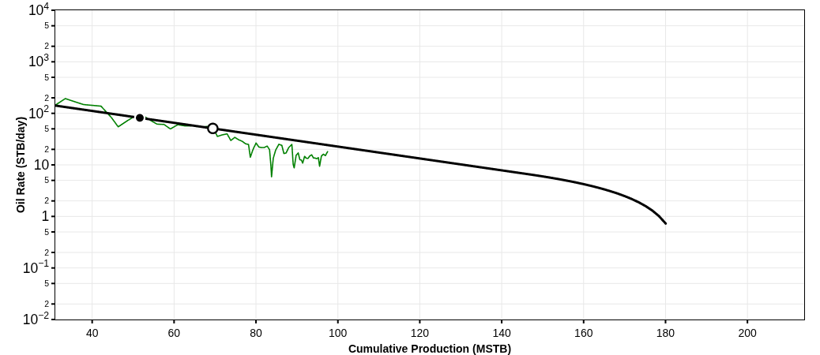
LEMKE 25-13N-9W 4H
35017247830000
Technical Volumes at 9 July 2026
Summary
Country: UNITED STATES
County: CANADIAN
Reservoir: CALUMET EAST
Operator: DEVON ENERGY PRODUCTION CO LP
Pad Name:
Reserves Classification:
Vintage:
Well Trajectory: horizontal
Lateral Length: 4849 ft
Fluid Pumped: 239811 STB
Proppant Pumped: 9032000 lbs
Stages: 0
Clusters:
Well Spacing:
Technical Volumes at 9 July 2026
Last Segment
Stream | Ultimate Volumes | Cumulative Production | Remaining Volumes | Total Production Time | D_{lim}(tan. eff) | Cutoff Rate
Segment | Start Date | q_{i} | D_{i}(sec. eff) | b
Oil | 178.22 | 69.46 | 108.76 | 50 yrs | 6.18 %/yr | 0
Oil | 2017-02-01 | 221.24 | 68.21 %/yr | 1

Slide 10
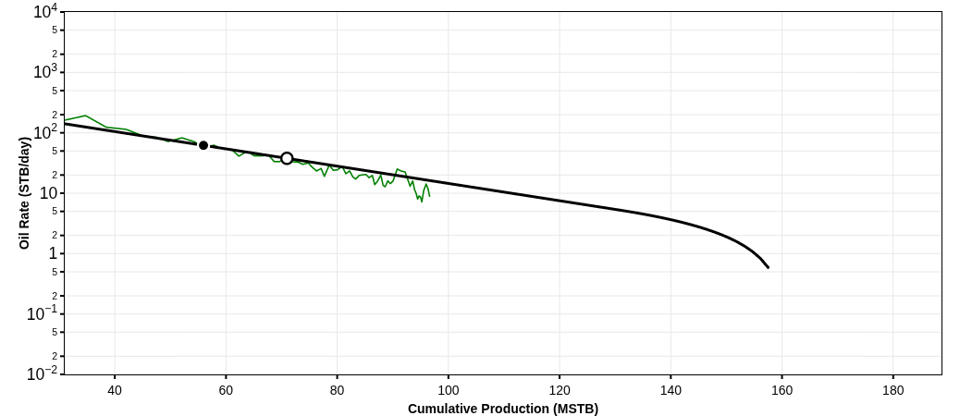
LEMKE 25-13N-9W 6H
35017247840000
Technical Volumes at 9 July 2026
Summary
Country: UNITED STATES
County: CANADIAN
Reservoir: WTNG-CHCSH TREND
Operator: DEVON ENERGY PRODUCTION CO LP
Pad Name:
Reserves Classification:
Vintage:
Well Trajectory: horizontal
Lateral Length: 4891 ft
Fluid Pumped: 315578 STB
Proppant Pumped: 11918000 lbs
Stages: 30
Clusters:
Well Spacing:
Technical Volumes at 9 July 2026
Last Segment
Stream | Ultimate Volumes | Cumulative Production | Remaining Volumes | Total Production Time | D_{lim}(tan. eff) | Cutoff Rate
Segment | Start Date | q_{i} | D_{i}(sec. eff) | b
Oil | 157.24 | 70.97 | 86.27 | 50 yrs | 6.18 %/yr | 0
Oil | 2017-03-01 | 216.88 | 72.31 %/yr | 1

Slide 11

LEMKE 25-13N-9W 3H
35017247850000
Technical Volumes at 9 July 2026
Summary
Country: UNITED STATES
County: CANADIAN
Reservoir: WTNG-CHCSH TREND
Operator: DEVON ENERGY PRODUCTION CO LP
Pad Name:
Reserves Classification:
Vintage:
Well Trajectory: horizontal
Lateral Length: 4904 ft
Fluid Pumped: 260655.86 STB
Proppant Pumped: 9784000 lbs
Stages: 0
Clusters:
Well Spacing:
Technical Volumes at 9 July 2026
Last Segment
Stream | Ultimate Volumes | Cumulative Production | Remaining Volumes | Total Production Time | D_{lim}(tan. eff) | Cutoff Rate
Segment | Start Date | q_{i} | D_{i}(sec. eff) | b
Oil | 154.89 | 68 | 86.89 | 50 yrs | 6.18 %/yr | 0
Oil | 2017-02-01 | 221.86 | 72.39 %/yr | 1

Slide 12
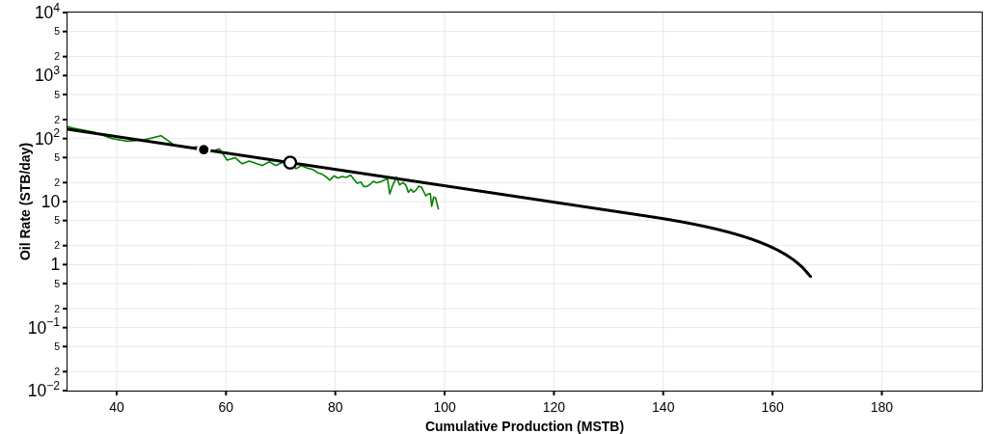
LEMKE 25-13N-9W 2H
35017247860000
Technical Volumes at 9 July 2026
Summary
Country: UNITED STATES
County: CANADIAN
Reservoir: WTNG-CHCSH TREND
Operator: DEVON ENERGY PRODUCTION CO LP
Pad Name:
Reserves Classification:
Vintage:
Well Trajectory: horizontal
Lateral Length: 4681 ft
Fluid Pumped: 262103.86 STB
Proppant Pumped: 9452000 lbs
Stages: 0
Clusters:
Well Spacing:
Technical Volumes at 9 July 2026
Last Segment
Stream | Ultimate Volumes | Cumulative Production | Remaining Volumes | Total Production Time | D_{lim}(tan. eff) | Cutoff Rate
Segment | Start Date | q_{i} | D_{i}(sec. eff) | b
Oil | 165.23 | 71.74 | 93.49 | 50 yrs | 6.18 %/yr | 0
Oil | 2017-02-01 | 223.96 | 71.01 %/yr | 1

Slide 13
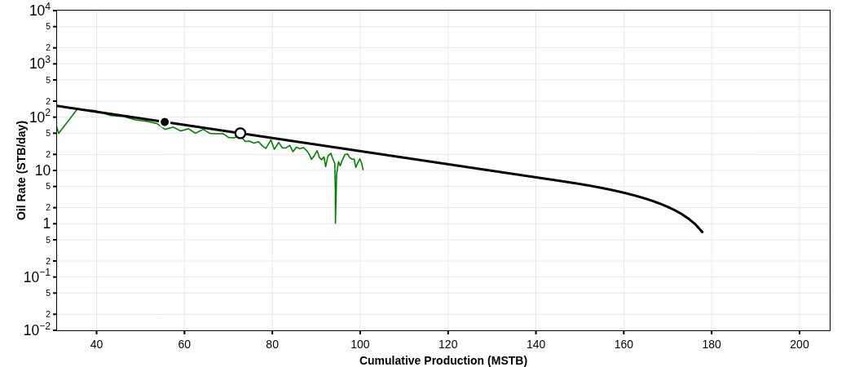
LEMKE 25-13N-9W 5H
35017247870000
Technical Volumes at 9 July 2026
Summary
Country: UNITED STATES
County: CANADIAN
Reservoir: WTNG-CHCSH TREND
Operator: DEVON ENERGY PRODUCTION CO LP
Pad Name:
Reserves Classification:
Vintage:
Well Trajectory: horizontal
Lateral Length: 4781 ft
Fluid Pumped: 325769 STB
Proppant Pumped: 11870000 lbs
Stages: 30
Clusters:
Well Spacing:
Technical Volumes at 9 July 2026
Last Segment
Stream | Ultimate Volumes | Cumulative Production | Remaining Volumes | Total Production Time | D_{lim}(tan. eff) | Cutoff Rate
Segment | Start Date | q_{i} | D_{i}(sec. eff) | b
Oil | 172.39 | 72.72 | 99.67 | 50 yrs | 6.18 %/yr | 0
Oil | 2017-03-01 | 223.74 | 69.83 %/yr | 1

Slide 14
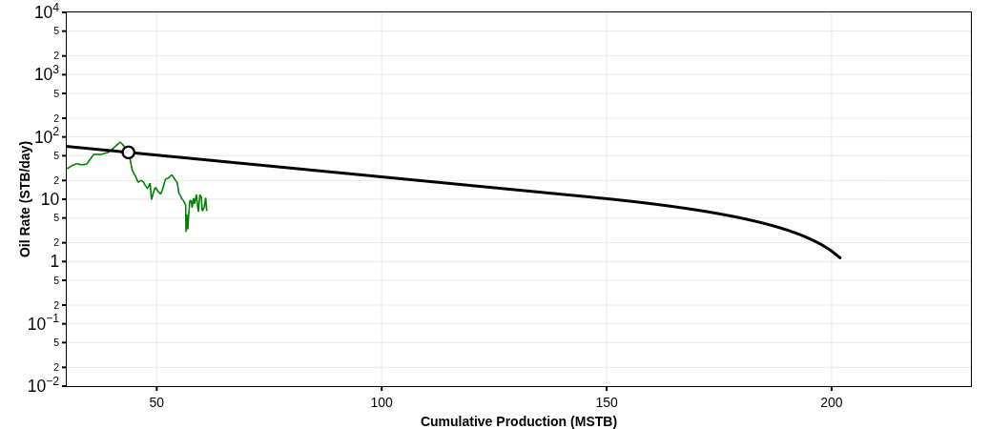
HOBSON 26-13N-9W 2H
35017247960000
Technical Volumes at 9 July 2026
Summary
Country: UNITED STATES
County: CANADIAN
Reservoir: WTNG-CHCSH TREND
Operator: DEVON ENERGY PRODUCTION CO LP
Pad Name:
Reserves Classification:
Vintage:
Well Trajectory: horizontal
Lateral Length: 4693 ft
Fluid Pumped: 258515.19 STB
Proppant Pumped: 8300000 lbs
Stages: 0
Clusters:
Well Spacing:
Technical Volumes at 9 July 2026
Last Segment
Stream | Ultimate Volumes | Cumulative Production | Remaining Volumes | Total Production Time | D_{lim}(tan. eff) | Cutoff Rate
Segment | Start Date | q_{i} | D_{i}(sec. eff) | b
Oil | 192.47 | 43.72 | 148.76 | 50 yrs | 6.18 %/yr | 0
Oil | 2017-01-01 | 101.24 | 37.3 %/yr | 1

Slide 15
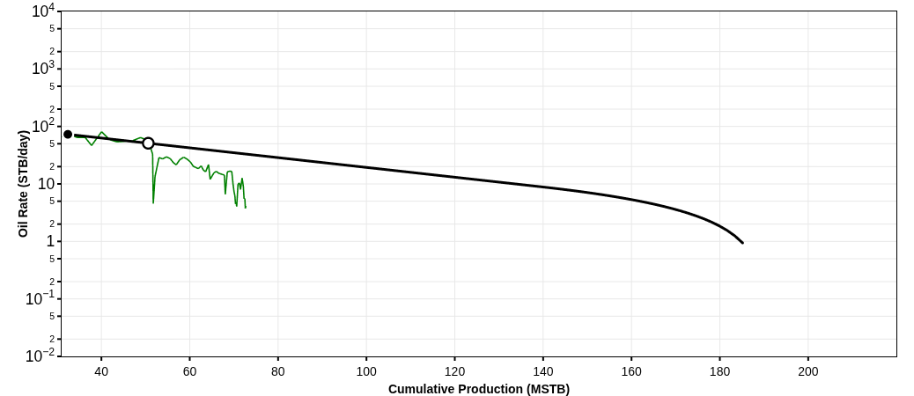
HOBSON 26-13N-9W 3H
35017247970000
Technical Volumes at 9 July 2026
Summary
Country: UNITED STATES
County: CANADIAN
Reservoir: WTNG-CHCSH TREND
Operator: DEVON ENERGY PRODUCTION CO LP
Pad Name:
Reserves Classification:
Vintage:
Well Trajectory: horizontal
Lateral Length: 4717 ft
Fluid Pumped: 335250 STB
Proppant Pumped: 9006000 lbs
Stages: 30
Clusters:
Well Spacing:
Technical Volumes at 9 July 2026
Last Segment
Stream | Ultimate Volumes | Cumulative Production | Remaining Volumes | Total Production Time | D_{lim}(tan. eff) | Cutoff Rate
Segment | Start Date | q_{i} | D_{i}(sec. eff) | b
Oil | 183.3 | 50.61 | 132.69 | 50 yrs | 6.18 %/yr | 0
Oil | 2017-01-01 | 118.62 | 45.95 %/yr | 1

Slide 16
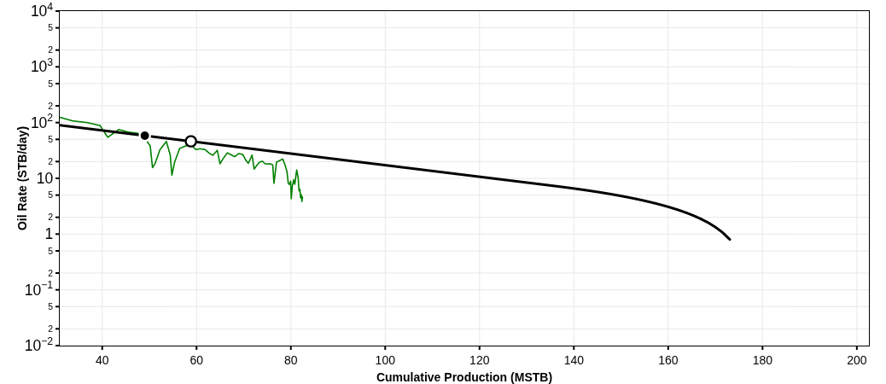
HOBSON 26-13N-9W 4H
35017247980000
Technical Volumes at 9 July 2026
Summary
Country: UNITED STATES
County: CANADIAN
Reservoir: WTNG-CHCSH TREND
Operator: DEVON ENERGY PRODUCTION CO LP
Pad Name:
Reserves Classification:
Vintage:
Well Trajectory: horizontal
Lateral Length: 4838 ft
Fluid Pumped: 346386 STB
Proppant Pumped: 10920000 lbs
Stages: 30
Clusters:
Well Spacing:
Technical Volumes at 9 July 2026
Last Segment
Stream | Ultimate Volumes | Cumulative Production | Remaining Volumes | Total Production Time | D_{lim}(tan. eff) | Cutoff Rate
Segment | Start Date | q_{i} | D_{i}(sec. eff) | b
Oil | 168.8 | 58.81 | 109.99 | 50 yrs | 6.18 %/yr | 0
Oil | 2017-03-01 | 125.04 | 52.22 %/yr | 1

Slide 17
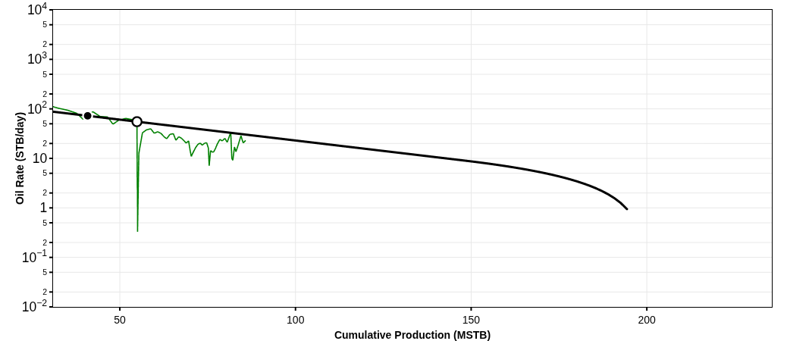
HOBSON 26-13N-9W 5H
35017247990000
Technical Volumes at 9 July 2026
Summary
Country: UNITED STATES
County: CANADIAN
Reservoir: WTNG-CHCSH TREND
Operator: DEVON ENERGY PRODUCTION CO LP
Pad Name:
Reserves Classification:
Vintage:
Well Trajectory: horizontal
Lateral Length: 4753 ft
Fluid Pumped: 316805 STB
Proppant Pumped: 10562000 lbs
Stages: 0
Clusters:
Well Spacing:
Technical Volumes at 9 July 2026
Last Segment
Stream | Ultimate Volumes | Cumulative Production | Remaining Volumes | Total Production Time | D_{lim}(tan. eff) | Cutoff Rate
Segment | Start Date | q_{i} | D_{i}(sec. eff) | b
Oil | 196.32 | 54.88 | 141.44 | 50 yrs | 6.18 %/yr | 0
Oil | 2017-03-01 | 116.51 | 45.24 %/yr | 1

Slide 18
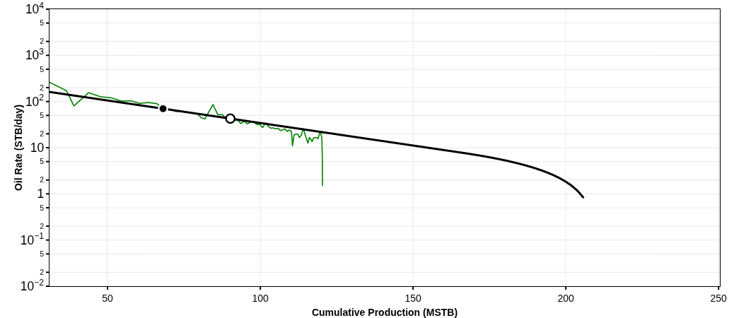
HOBSON 26-13N-9W 6H
35017248000000
Technical Volumes at 9 July 2026
Summary
Country: UNITED STATES
County: CANADIAN
Reservoir: WTNG-CHCSH TREND
Operator: DEVON ENERGY PRODUCTION CO LP
Pad Name:
Reserves Classification:
Vintage:
Well Trajectory: horizontal
Lateral Length: 4846 ft
Fluid Pumped: 328824 STB
Proppant Pumped: 10340000 lbs
Stages: 0
Clusters:
Well Spacing:
Technical Volumes at 9 July 2026
Last Segment
Stream | Ultimate Volumes | Cumulative Production | Remaining Volumes | Total Production Time | D_{lim}(tan. eff) | Cutoff Rate
Segment | Start Date | q_{i} | D_{i}(sec. eff) | b
Oil | 208.68 | 90.19 | 118.49 | 50 yrs | 6.18 %/yr | 0
Oil | 2017-01-01 | 240.3 | 66.35 %/yr | 1

Slide 19
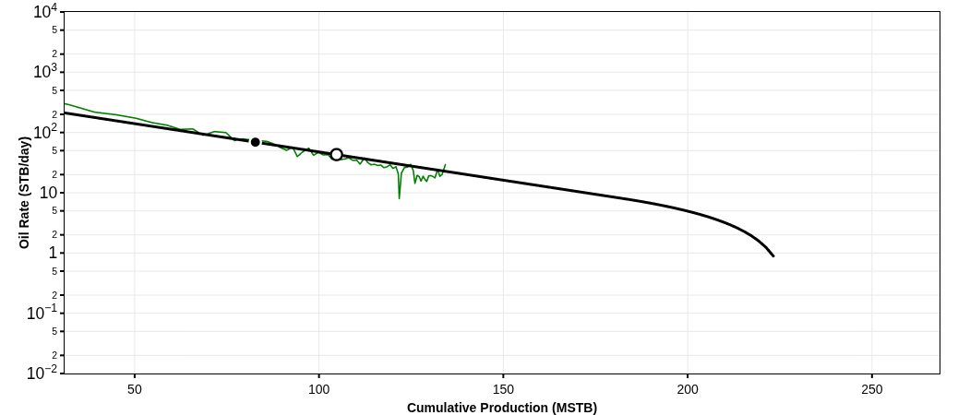
HOBSON 26-13N-9W 7H
35017248010000
Technical Volumes at 9 July 2026
Summary
Country: UNITED STATES
County: CANADIAN
Reservoir: WTNG-CHCSH TREND
Operator: DEVON ENERGY PRODUCTION CO LP
Pad Name:
Reserves Classification:
Vintage:
Well Trajectory: horizontal
Lateral Length: 4804 ft
Fluid Pumped: 324888 STB
Proppant Pumped: 11146000 lbs
Stages: 30
Clusters:
Well Spacing:
Technical Volumes at 9 July 2026
Last Segment
Stream | Ultimate Volumes | Cumulative Production | Remaining Volumes | Total Production Time | D_{lim}(tan. eff) | Cutoff Rate
Segment | Start Date | q_{i} | D_{i}(sec. eff) | b
Oil | 223.6 | 104.75 | 118.85 | 50 yrs | 6.18 %/yr | 0
Oil | 2017-02-01 | 244 | 65.82 %/yr | 1

Slide 20
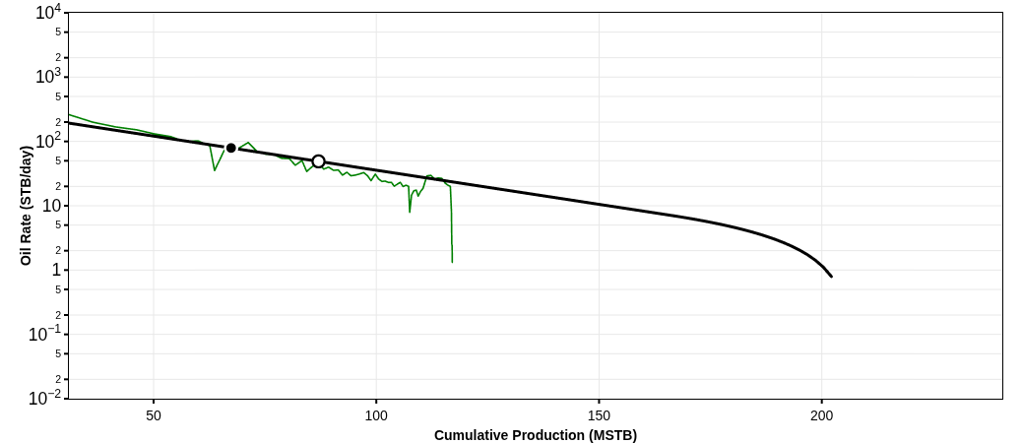
HOBSON 26-13N-9W 8H
35017248020000
Technical Volumes at 9 July 2026
Summary
Country: UNITED STATES
County: CANADIAN
Reservoir: WTNG-CHCSH TREND
Operator: DEVON ENERGY PRODUCTION CO LP
Pad Name:
Reserves Classification:
Vintage:
Well Trajectory: horizontal
Lateral Length: 4853 ft
Fluid Pumped: 243112 STB
Proppant Pumped: 9344000 lbs
Stages: 30
Clusters:
Well Spacing:
Technical Volumes at 9 July 2026
Last Segment
Stream | Ultimate Volumes | Cumulative Production | Remaining Volumes | Total Production Time | D_{lim}(tan. eff) | Cutoff Rate
Segment | Start Date | q_{i} | D_{i}(sec. eff) | b
Oil | 200.43 | 87.03 | 113.4 | 50 yrs | 6.18 %/yr | 0
Oil | 2017-02-01 | 235.58 | 67.77 %/yr | 1

